Slide 1
MANAGING FX RISK IN EMERGING MARKETS
KEY CHALLENGES MAY 4, 2017

Slide 2
EM FX PERFORMACE IS A MIXED BAG

Slide 3
EMERGING MARKETS PRESENT UNIQUE CHALLENGES
NO ONE SIZE FITS ALL APPROACH
WHAT IS FAIR VALUE
REGULATIONS
VOLATILITY
LIQUIDITY
COUNTRY RISK

Slide 4
DEFINING THE UNIVERSE: EMERGING VS FRONTIER
MEXICO VS MOZAMBIQUE
SOUTH AFRICA VS SURINAM

Slide 5
MEX PESO: 10 YEAR OPTIONS MOZAMBIQUE: 3M FORWARDS?

Slide 6
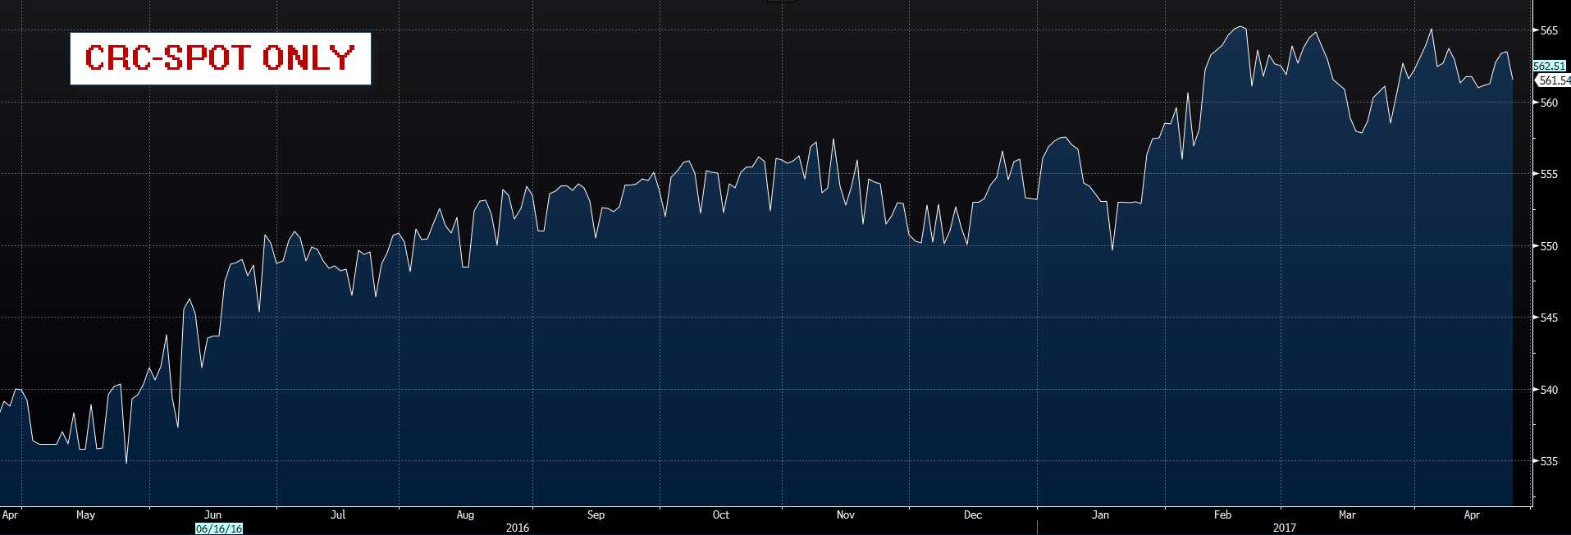
SOUTH AFRICA: 30Y CCS SWAZILAND: SPOT FX

Slide 7
DETERMINING FAIR VALUE
TIME HORIZON
CYLICAL VS STRUCTURAL

Slide 8
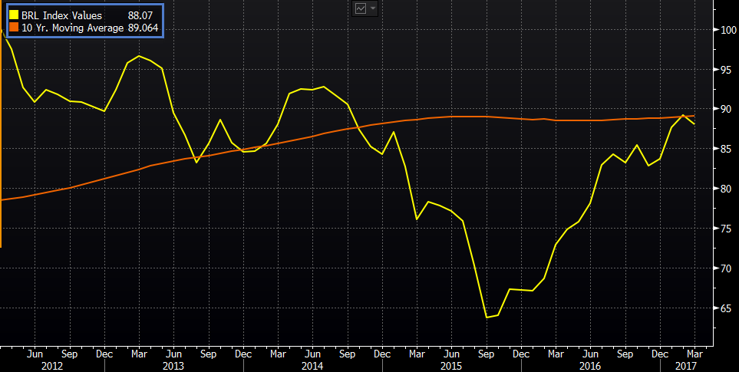
LONG TERM FAIR VALUE: REAL EFFECTIVE EXCHANGE RATES

Slide 9
MULTILATERAL VS BILATERAL VALUATION

Slide 10
FX MARKET POSITIONING

Slide 11
STRUCTURAL CHANGES: MXN

Slide 12
STRUCTURAL CHANGES:CNY/CNH

Slide 13
THE REGULATORY ENVIRONMENT TWO DIFFERENT APPROACHES
PERMITTED VS NOT PERMITTED
PRE-TRADE AUTHORIZATION VS POST TRADE REVIEW
CURRENT ACCOUNT VS CAPITAL ACCOUNT CONVERTABILITY
INTERNAL COMMUNICATION IS VITAL

Slide 14
CURRENCY RESTRICTIONS: THE IMF STANDARD

Slide 15
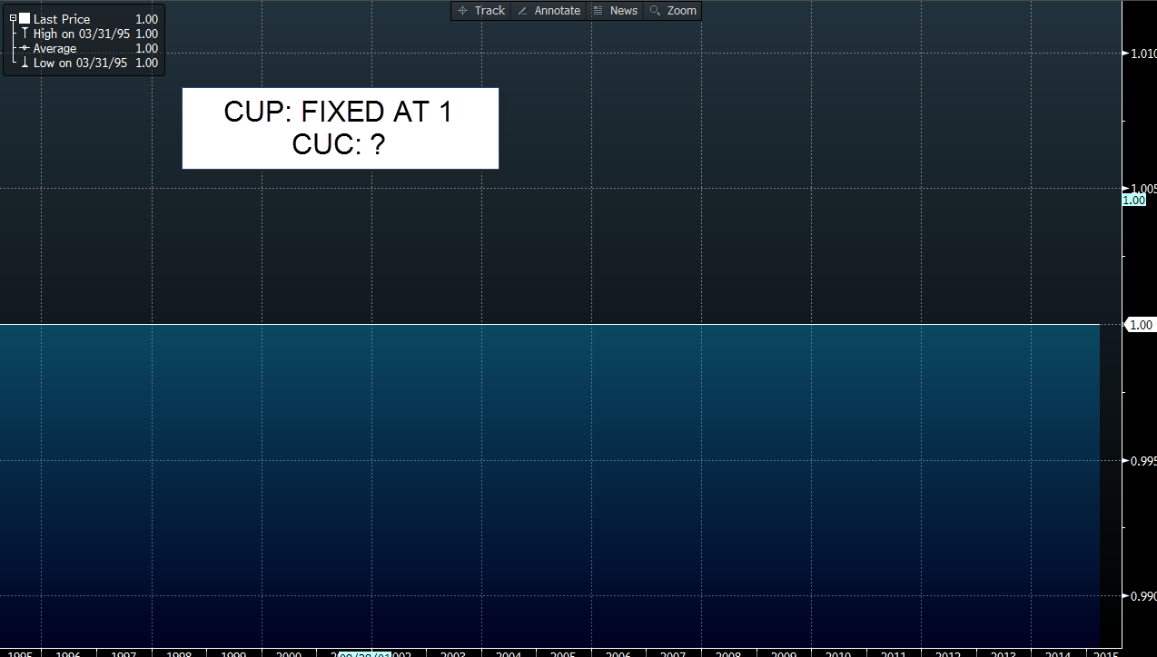
STRUCTURAL CHANGES: CUP?

Slide 16
VOLATILITY
DIFFERENT ORDER OF MAGNITUDE
VOLATILITY CHANGES DEFINITION OF MATERIALITY

Slide 17
HIGHER VOL: WHAT’S THE P&L IMPACT?

Slide 18
HEDGING OPTIONS
SPOT: TIME ZONE
FORWARD: TENOR LIMITATIONS: ONSHORE VS OFFSHORE
DERIVATIVES: REGULATORY CONSTRAINTS

Slide 19
CHINA HAS THREE CURVES

Slide 20
FORWARDS VS DEPOS

Slide 21
LIQUIDITY
TIME ZONE SENSITIVE
UNIVERSE OF MARKET PARTICIPANTS

Slide 22
FAIR VALUE:SHORT TERM LIQUIDITY ANALYSIS

Slide 23
PUTTING IT ALL TOGETHER: A FRAMEWORK FOR COUNTRY RISK

Slide 24
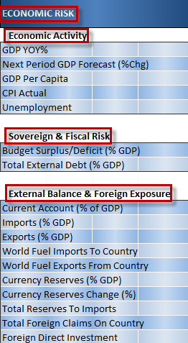
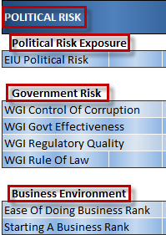
CREATE YOUR OWN COUNTRY RISK MODEL: THREE COMPONENTS

Slide 25
WHAT’S MOVING MAGNITUDE TIME HORIZON

Slide 26
LOOKING FOR CORRELATION

Slide 27
FX FORECASTS (2) SCENARIO ANALYSIS

Slide 28
FX FORECASTS (1) ANALYSTS

Slide 29
PUTTING IT TOGETHER: MARKET SCENARIO + INTERNAL GUIDELINES

